Slide 1
Algorithm used in water quality analysis
Calculating the WQI is time-consuming, but estimating WQI is inevitable for water resources management. For this purpose, three Machine Learning (ML) algorithms, namely, Gene Expression Programming (GEP), M5P Model tree, and Multivariate Adaptive Regression Splines (MARS), were employed to predict WQI.

Slide 2
Innovation steps
Introduction: Provide background information on the purpose of the water quality analysis and its significance. Data Collection: Detail the sources of your data, including the locations and frequency of sampling. Parameters Analyzed: List the specific water quality parameters assessed, such as pH, dissolved oxygen, turbidity, etc. WQI Calculation: Explain how you calculated the Water Quality Index using the chosen algorithm. For example, WQI calculation often involves assigning weights and ratings to different parameters. Interpretation: Discuss the interpretation of the calculated WQI values. Explain what the values indicate about the overall water quality. Results and Findings: Present the WQI values for each sample or location, and highlight any trends or patterns observed. Comparison: If applicable, compare the WQI values to relevant water quality standards or guidelines set by regulatory agencies. Recommendations: Based on your findings, suggest any necessary actions or interventions to improve water quality. Limitations: Acknowledge any limitations in the analysis, such as data gaps, assumptions, or potential sources of error. Conclusion: Summarize the key findings and their implications for water quality management. References: Include a list of sources and references used in the analysis.

Slide 3
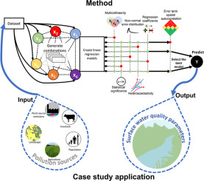
Case study application

Slide 4
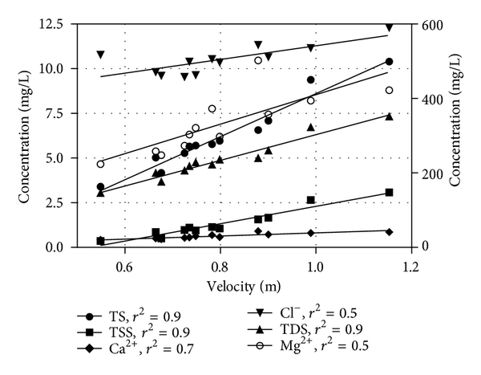
Graphical representation

